Slide 1
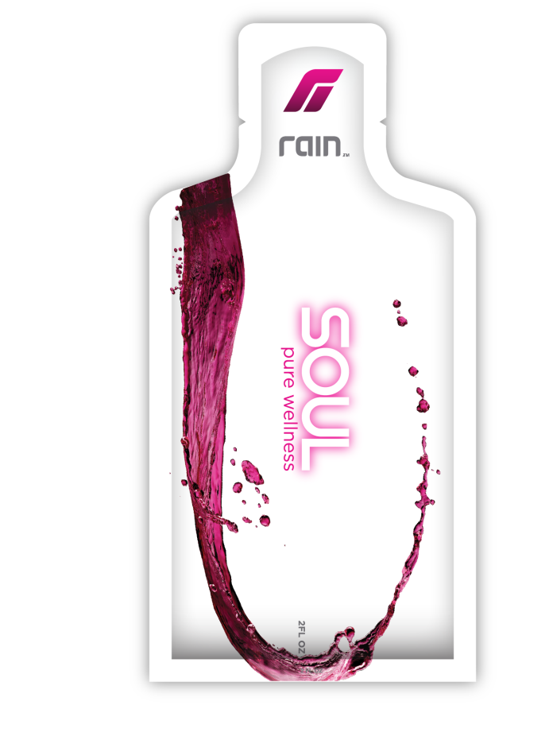
The Science Inside SOUL
Presented by:
Dr. Susan Mattes Bostian
Integrative Holistic Health and Nutrition Specialist
www.drsusansph.com
(610) 417 -2448
This presentation is the intellectual property of Dr. Susan, and can be shared as long as credit is given to the author and sources cited.

Slide 2
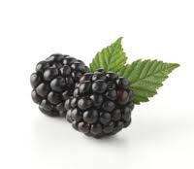
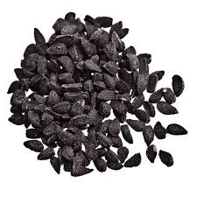
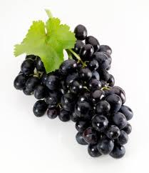
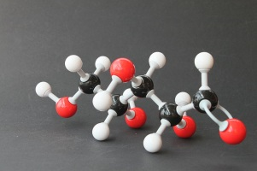
What’s in SOUL?
Black Raspberry Seed
Black Cumin Seed
Grape Chardonnay Seed
D-Ribose

Slide 3
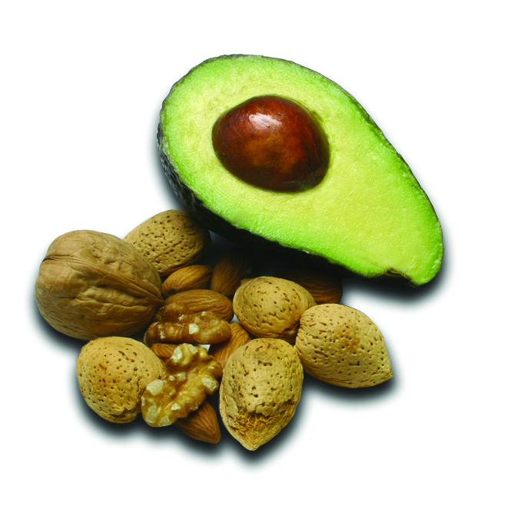
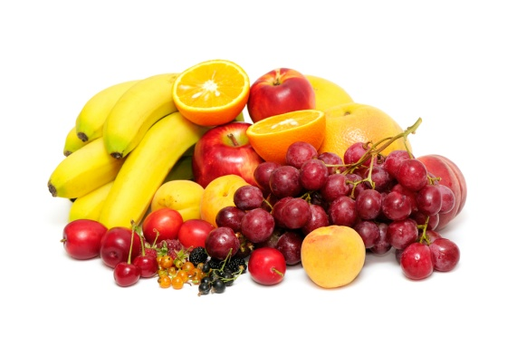
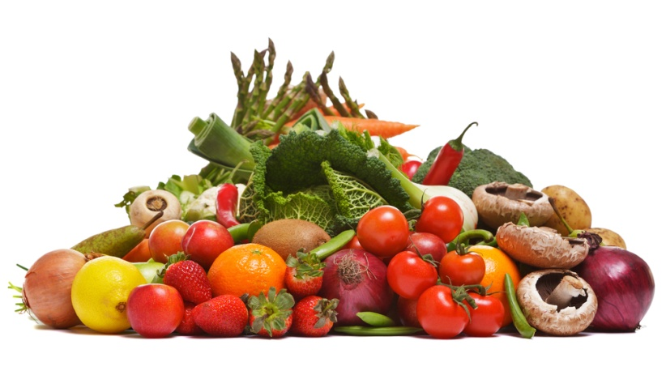
The Benefits of Soul
Provides the equivalent of 8-10 servings of fruits
and vegetables, and 2-3 servings of essential fatty
acids.
plus
plus

Slide 4
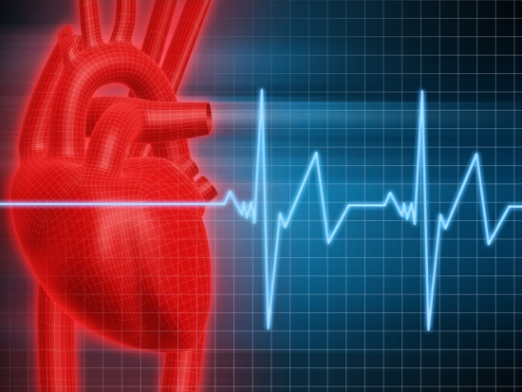
STRESS…the silent killer
Stress:
The body’s response to events, situations, trauma, that creates an acidic environment that promotes illness, inflammation, and even cell death or alterations that affect their function. (National Academy of Sciences)
Four Types of Stress:
Emotional
Physical
Chronic
Pharmaceutical-Induced
Notes:
National Academy of Sciences
Harvard Medical Center

Slide 5
What Stress Affects:
Gene activity (especially when there is no trauma to fight)
Inflammation response (acute and chronic)
Hormone production and release
Nutrient absorption
Blood Pressure/heart rate and efficiency
How body responds to treatment protocols
Nervous system response
Cardiovascular health
Notes:
Indian Journal of Endocrinology and Medicine

Slide 6
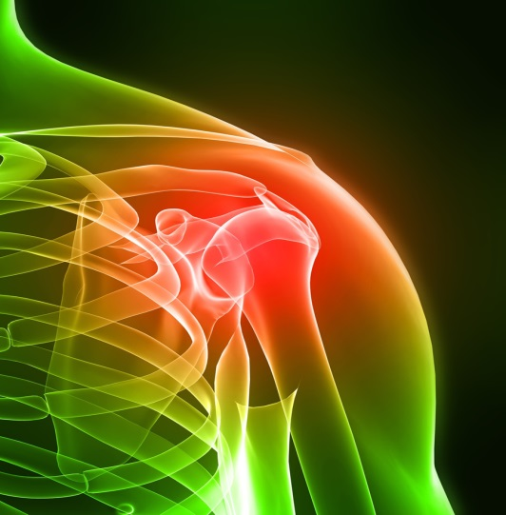
Inflammation
Acute versus Chronic
ACUTE
Body’s response to trauma such as injury, surgery, genetic illness
CHRONIC
Causes disease, and system shut down…the “On” switch to the immune system gets stuck in that position
Notes:
National Academy of Sciences
Lehigh Valley Health Network

Slide 7

The Science of Soul
Backed by clinical research, SOUL contains seed-based nutrition, using a cold-pressed process that protects the nutritional integrity of the seeds.
Black Raspberry, Black Cumin, Grape Chardonnay, and D-Ribose are contained to offer exceptional nutrient absorption, anti-inflammatory properties, fiber, vitamins, minerals, omegas, and the antioxidants needed to promote healthy living and support a healthy response to stress.
Let SOUL be your answer to the number one killer….STRESS.
Notes:
University of Maryland, Ohio State, Berman Cancer Center, Thomas Jefferson University, University of California,
American Journal of Clinical Nutrition

Slide 8
Why Black Raspberry?
Assists with balancing the body’s pH
Assists with nutrient absorption, has vitamins, minerals, and fiber
Anti-oxidant and helps eliminate free radicals in the body
Has been used in cancer treatment and prevention
Helps boost immune system
Helps stabilize and restore the insulin-glucose levels in the body
Has been shown to reduce cancer tumors in animals (Ohio State/Livestrong)
Has been linked to anti-aging properties
Source of phytochemicals and high levels of anthocyanins and other flavonoids.
Greek mythology associates them with fertility (Indian Journal of Endocrinology)
Notes:
BLACK RASPBERRY POTENTIAL
, PITFALLS AND PROGRESS
Courtney Weber
Associate Professor
Department of Horticultural Sciences
Cornell University, NYSAES
Geneva, NY 14456
American Cancer Society/Ohio State Univeristy
Livestrong.org
Mayo Clinic
Amer

Slide 9
Why Black Cumin?
Scientific evidence suggests that black seed might help:
boost the immune system
fight cancer
lessen allergic reactions
Black Cumin (Particularly in non-USA countries) has been used for:
Digestive Issues
Cancer treatment and prevention
Diabetes
Strengthen the Immune System
Psoriasis and other skin conditions
Asthma and allergies
Notes:
Mayo Clinic
Indian Journal of Endocrinology
History of the Ages

Slide 10
Black Cumin, continued
Companies are working to patent black cumin protocols for treating diabetes, cancer cell growth, viruses, psoriasis, asthma, immune system dysfunctions. This tells us that black cumin is definitely a super seed!
Other documented uses across the ages/cultures:
Increase breast milk flow/alleviate menstruation issues
Help with digestive issues
Increase energy
Treat pancreatic cancer
Anti-parasitic
Effective for various skin conditions
Treat tumors in eyes, abdomen, and liver
Lowers blood pressure and cholesterol
Notes:
University of Minnesota

Slide 11
Why Grape Chardonnay?
50 times more potent than Vitamin E and C in isolation, and is a natural anti-allergen and anti-inflammatory.
Has been used to treat and/or prevent:
Diabetes
Asthma and hay fever
Skin disorders
Used as a potent anti-inflammatory
Arthritis, ulcerative colitis, Chrone’s
Cardiovascular disease
Brain health
Cancer (neutralizes free radicals that damage DNA)
Notes:
Decrease in prostate cancer in men by 40%...(ACS)

Slide 12

Why D-Ribose?
D-Ribose: The sugar that boosts the energy level of ATP. Well absorbed, current food sources do not supply enough synthesized ribose from glucose to meet the body’s needs.
Documented Uses of D-Ribose:
Promote recovery of ATP (adenosine triphosphate)
Provide energy for cellular function
Make up genetic material (DNA and RNA)
Prevent cramping, muscle fatigue
Treat fibromyalgia, and chronic fatigue
Promotes mental clarity and focus
Increase power productivity in athletes
Restores energy and function of the heart
Notes:
Journal of Alternative and Complementary Medicine, 2009
Dr. Terjung, Athltetic performance
University of BONN, Germany
Association for Academic Surgery
Society of University Surgeons

Slide 13
Seed Based Nutrition at it’s finest…
DO YOU HAVE SOUL?

Slide 14
Please note that the information in this presentation is not mean to take the place of the advice from your medical practitioner, nor do we make any claims of disease or health cures with the products or optional context of care that may be discussed during the presentation. Always consult your physician.
This presentation has been prepared by Integrative Holistic Health and Nutrition Specialist,
Dr. Susan Mattes Bostian
www.drsusansph.com
Located in Pennsylvania
drsusansph@gmail.com

